Slide 1
16 Laurent Series. Residue Integration

Slide 2
16.1 Laurent Series

Slide 3
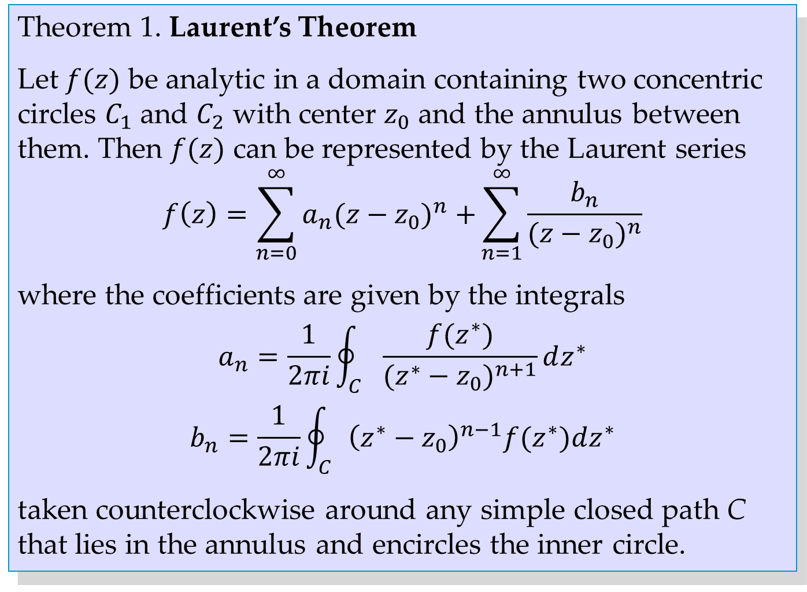
Theorem 1. Laurent’s Theorem
Let $f(z)$ be analytic in a domain containing two concentric circles $C_{1}$ and $C_{2}$ with center $z_{0}$ and the annulus between them. Then $f(z)$ can be represented by the Laurent series
$$f\left(z\right)=\sum_{n=0}^{∞}{a_{n}{(z−z_{0})}^{n} +\sum_{n=1}^{∞}{\frac{b_{n}}{{(z−z_{0})}^{n}}}}$$
where the coefficients are given by the integrals
$$a_{n}=\frac{1}{2πi}\oint_{C}{\frac{f(z^{∗})}{{(z^{∗}−z_{0})}^{n+1}}dz^{∗}}$$
$$b_{n}=\frac{1}{2πi}\oint_{C}{{\left(z^{∗}−z_{0}\right)}^{n−1}f(z^{∗})dz^{∗}}$$
taken counterclockwise around any simple closed path C that lies in the annulus and encircles the inner circle.
Notes:
‘C that lies’

Slide 4
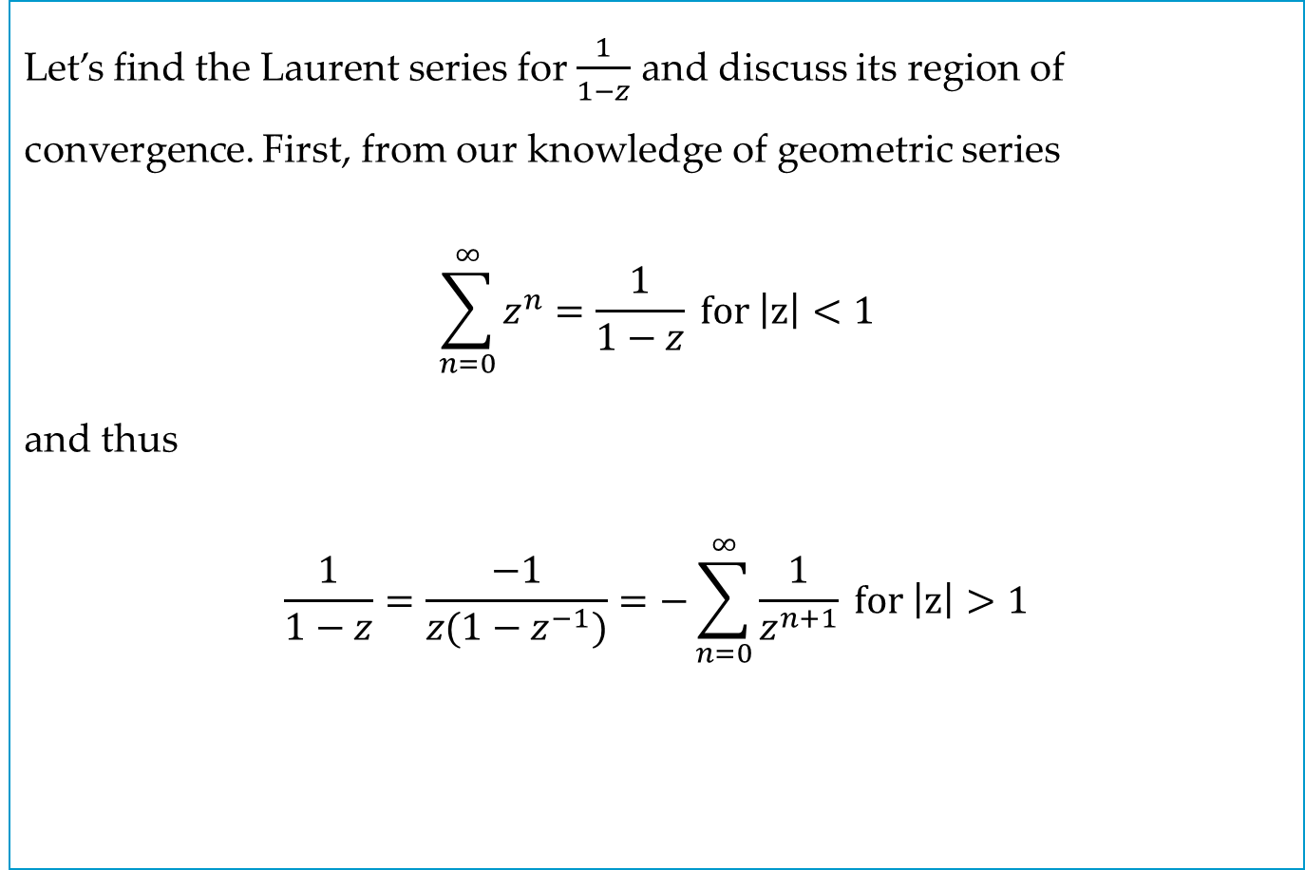
EXAMPLE 3
Let’s find the Laurent series for $\frac{1}{1−z}$ and discuss its region of convergence. First, from our knowledge of geometric series
$$\sum_{n=0}^{∞}{z^{n}=\frac{1}{1−z}} for \left|z\right|<1$$
and thus
$$\frac{1}{1−z}=\frac{−1}{z(1−z^{−1})}=−\sum_{n=0}^{∞}{\frac{1}{z^{n+1}}} for \left|z\right|>1$$
Notes:
Change sign on first equation to less than

Slide 5
16.2 Singularities and Zeros. Infinity.

Slide 6
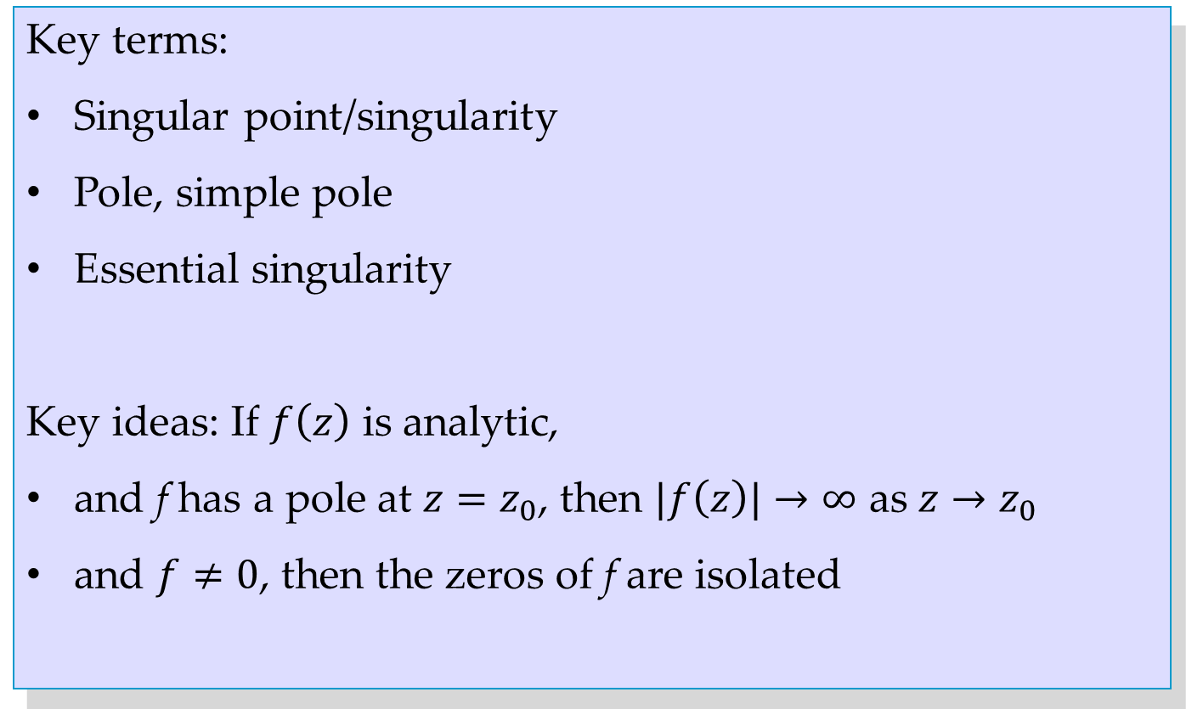
Key terms:
Singular point/singularity
Pole, simple pole
Essential singularity
Key ideas: If $f\left(z\right)$ is analytic,
and f has a pole at $z=z_{0}$, then $|f\left(z\right)|→∞$ as $z→z_{0}$
and $f≠0$, then the zeros of f are isolated

Slide 7
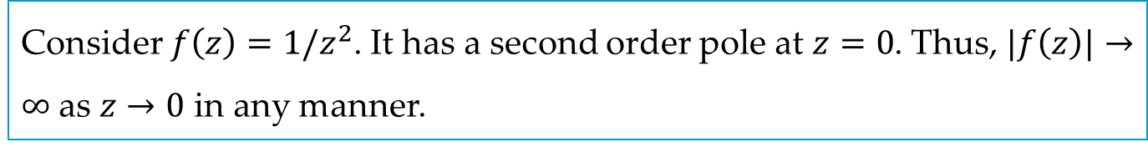
EXAMPLE 2
Consider $f\left(z\right)=1/z^{2}$. It has a second order pole at $z=0$. Thus, $|f\left(z\right)|→∞$ as $z→0$ in any manner.

Slide 8
16.3 Residue Integration Method

Slide 9
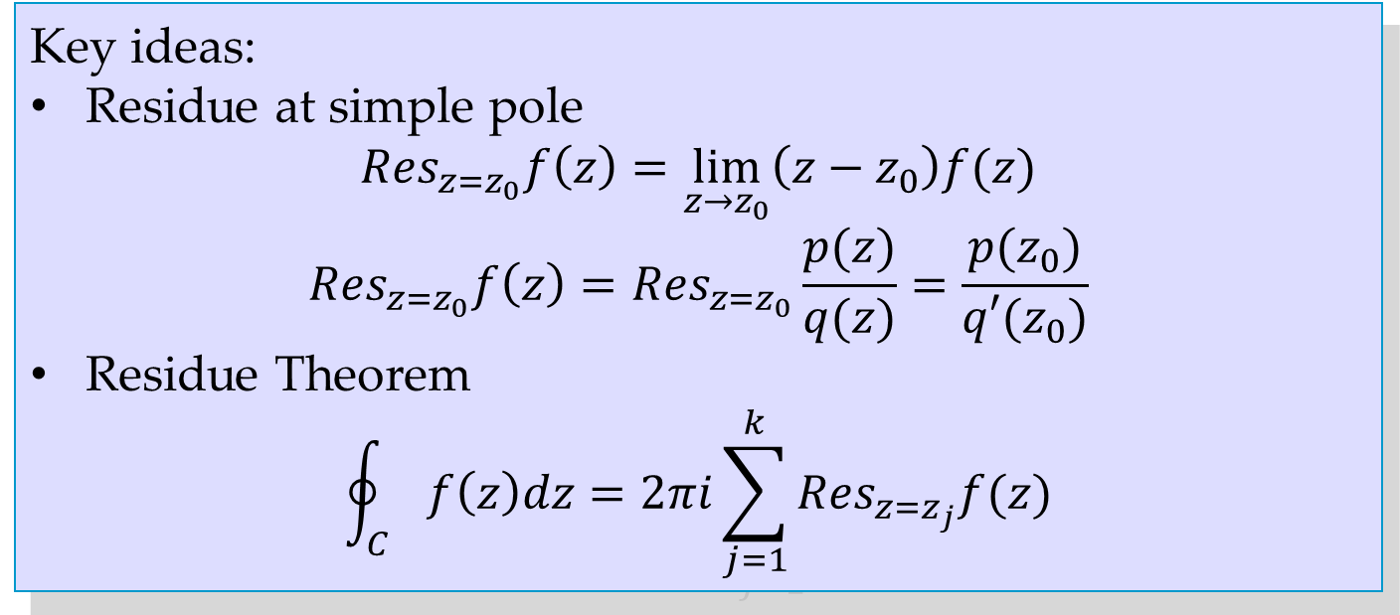
Key ideas:
Residue at simple pole
$${Res}_{z=z_{0}}f\left(z\right)=\lim_{z→z_{0}}\left(z−z_{0}\right)f(z)$$
$${Res}_{z=z_{0}}f\left(z\right)={Res}_{z=z_{0}}\frac{p(z)}{q(z)}=\frac{p(z_{0})}{q′(z_{0})}$$
Residue Theorem
$$\oint_{C}{f\left(z\right)dz=2πi\sum_{j=1}^{k}{{Res}_{z=z_{j}}f(z)}}$$

Slide 10
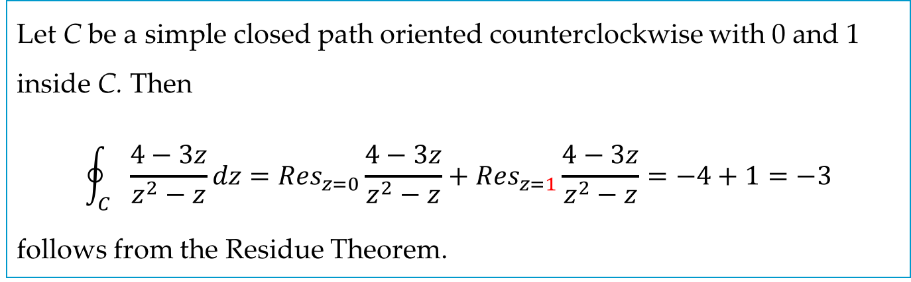
EXAMPLE 5
Let C be a simple closed path oriented counterclockwise with 0 and 1 inside C. Then
$$\oint_{C}{\frac{4−3z}{z^{2}−z}dz={Res}_{z=0}\frac{4−3z}{z^{2}−z}+{Res}_{z=1}\frac{4−3z}{z^{2}−z}=−4+1=−3}$$
follows from the Residue Theorem.

Slide 11
16.4 Residue Integration of Real Integrals

Slide 12
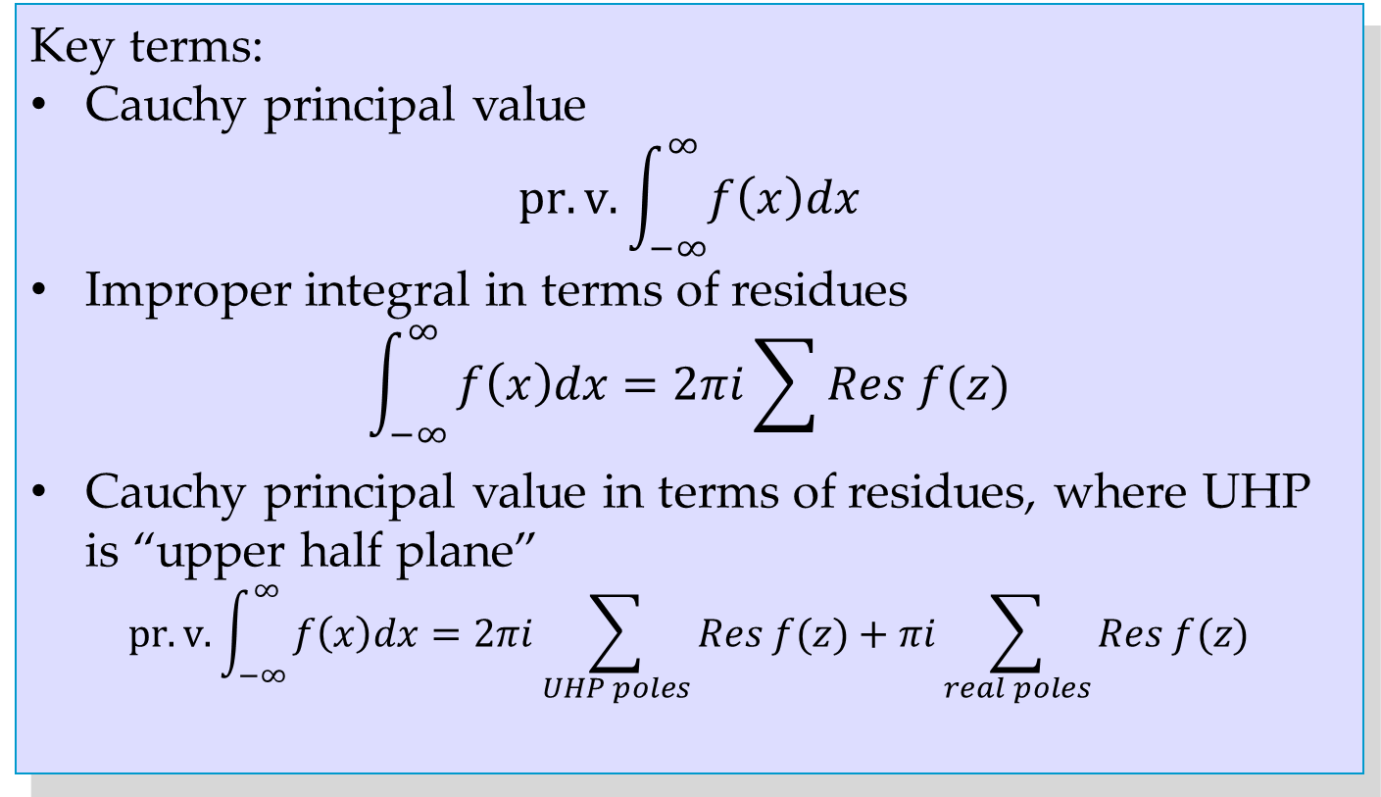
Key terms:
Cauchy principal value
$$pr.v.\int_{−∞}^{∞}{f\left(x\right)dx}$$
Improper integral in terms of residues
$$\int_{−∞}^{∞}{f\left(x\right)dx=2πi\sum{Res f(z)}}$$
Cauchy principal value in terms of residues, where UHP is “upper half plane”
$$pr.v.\int_{−∞}^{∞}{f\left(x\right)dx=2πi\sum_{UHP poles}{Res f(z)}+πi\sum_{real poles}{Res f(z)}}$$

Slide 13
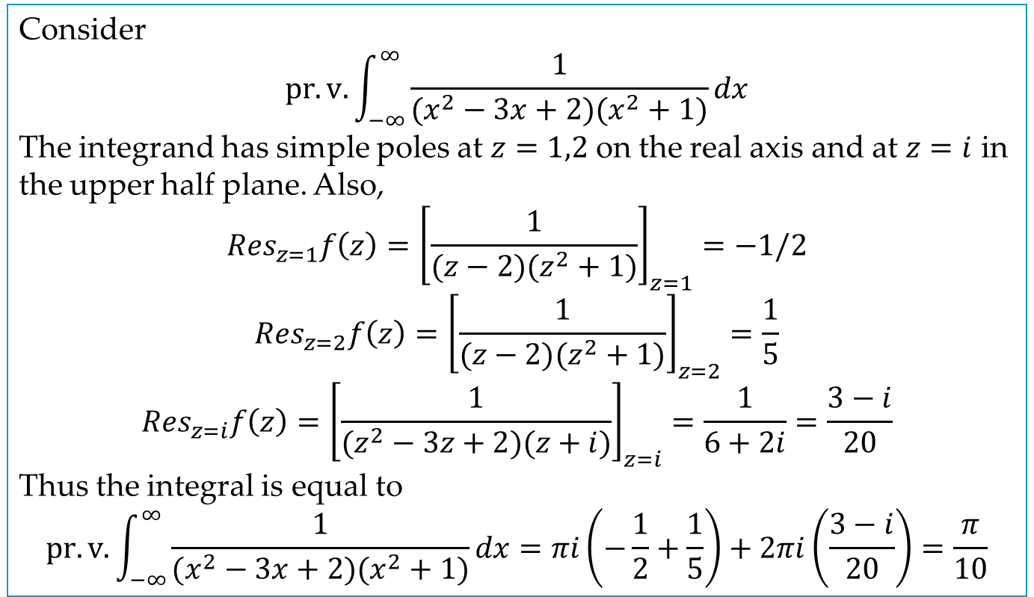
EXAMPLE 1
Consider
$$pr.v.\int_{−∞}^{∞}{\frac{1}{(x^{2}−3x+2)(x^{2}+1)}dx}$$
The integrand has simple poles at $z=1,2$ on the real axis and at $z=i$ in the upper half plane. Also,
$${Res}_{z=1}f\left(z\right)={\left[\frac{1}{(z−2)(z^{2}+1)}\right]}_{z=1}=−1/2$$
$${Res}_{z=2}f\left(z\right)={\left[\frac{1}{(z−2)(z^{2}+1)}\right]}_{z=2}=\frac{1}{5}$$
$${Res}_{z=i}f\left(z\right)={\left[\frac{1}{(z^{2}−3z+2)(z+i)}\right]}_{z=i}=\frac{1}{6+2i}=\frac{3−i}{20}$$
Thus the integral is equal to
$$pr.v.\int_{−∞}^{∞}{\frac{1}{(x^{2}−3x+2)(x^{2}+1)}dx=πi\left(−\frac{1}{2}+\frac{1}{5}\right)+2πi\left(\frac{3−i}{20}\right)=\frac{π}{10}}$$

